Slide 1
Using the NASFM Risk Evaluation MATRIXTM
www.safetylayering.solutions
Presented by
National Association of State Fire Marshals
Notes:
Welcome to Using the NASFM Risk Evaluation MatrixTM. The objective of this training presentation is to provide an overview of the use and benefits of utilizing the NASFM Risk Evaluation MATRIXTM. It is highly recommended that you first take advantage of the NASFM Fire Research and Education training, Evaluating Fire Risk in Existing Buildings” which can be found at firemarshals.org, selecting the Programs tab and clicking on Project FAIL-SAFE, which provides background on the basic concepts and methodologies of performing fire safety risk evaluation’s in buildings.

Slide 2
What is the NASFM Risk Evaluation MATRIXTM
An easy to use tool to evaluate an existing building’s fire safety risk
Designed using a simple question and answer format similar to many tax preparation software packages
A companion risk evaluation tool that is not a substitute for periodic code inspections.
Notes:
************The NASFM Risk Evaluation MATRIXTM was developed as a web-based application by the National Association of State Fire Marshals Fire Research and Education Foundation to assist the fire service in protecting communities through informed fire prevention and mitigation.
***********The tool provides an easy-to-use method for evaluating fire risk in EXISTING buildings similar to “DIY” tax preparation software. It’s based on Chapter 14 of the International Existing Building Code (the IEBC), using the 23 quantifiable critical building components identified within the code. By simply answering questions with the MATRIXTM you will automatically be evaluating specific safeguards within a building. The MATRIXTM identifies the assigned value for safeguards you have identified, keeping a running total of the safety score and providing an final risk evaluation of the combined level of safeguards for that building.
You will also see a comparison of how your individual building scores against the scores from other buildings within your jurisdiction that have been evaluated. This comparison is broken down by each of the 23 critical life safety factors using the average scores across your community. Finally, using the tool you will be able to examine the average scores for each individual occupancy type within your community to establish if any particular type or types are most commonly risk deficient.
Further examples of how to use the tool will be provided later in this training presentation.
It is important to note that the IEBC limits the evaluated occupancy types to A-1, A-2, A-3, A-4, B, E, F-1, F-2, I-2, M, R-1, R-2, R-4, S-1 and S-2. Thus, the MATRIXTM can only be used for these most common occupancy types. All other types are outside of the scope of Chapter 14 and should be evaluated using another method.
***********Please note, the NASFM Risk Evaluation MATRIXTM is NOT intended as a substitute for regularly scheduled fire or building code inspections nor is it intended to require any retro-active corrections to a building.

Slide 3
Important Notes on Use
Your evaluations are secure
The results are only as good as the data entered
Navigation of the tool is designed through the use of a toolbar and tabs divided into four main categories:
Building Data (address, height, area, occupancy load, etc.)
Systems (sprinklers, fire alarms, standpipes, HVAC)
Means of Egress (exits, corridors, stairwells, elevators, etc.)
Building Use & Processes (includes uncommon special situations that may be present)
Answers can be saved in several manners
Some questions use the mathematical symbols < (less than), > (greater than), < (less than or equal to), and > (greater than or equal to).
Notes:
Now let’s take a quick look at some of the important navigational elements of the tool and its use. Remember, further examples of how to use this tool will be provided later in this training presentation.
First, it’s important that you understand all evaluations you complete are secured within your account and can only be viewed by those who have account access permission.
All questions must be answered to receive a total building score. If you are not sure of how to answer to any question consult the tips provided by using the help button next to each question. By clicking on the help button next to each question you will find additional information for that particular question. This includes code references that should be consulted to ensure you have a clear understanding on how to properly answer the question.
*******************Remember, the results are only as good as the information you input into the tool, or, as we say in the fire service, garbage in…garbage out.
**************Navigation of the tool is designed to be intuitive, allowing the user to enter information on life safety systems and components as they are encountered within a building by simply clicking on one of the horizontal tabs and then using that tab’s vertical menu found, which appears on the left side of the page. For ease, each building evaluation is broken into general building information, fire protection systems, egress components, how the building is used, transferring the acquired answers into scores which are tabulated on a results page.
***************It is important to save your information as you progress through the questions on the tool. This can be done by clicking on the “Save and Continue” button on the bottom of each page. All answers are also saved when you navigate away from the page, even if you have not saved your answers previously. Questions that have not been answered on a page when using the “Save and Continue” button will display a message reminding you that all questions are required to be answered before allowing the information to be saved. If you navigate away from the page before answering all questions the answers you have provided will be saved but you will not receive a notice of incomplete answers unless you check your progress on the Results tab.
***************Some mathematical symbols are used within the tool as depicted on this slide. A good way to remember this is that the symbol will always point AWAY from the number if it is less than the number and point TOWARD the number if it is greater than the number. Others may have learned this by thinking of an alligator who’s mouth is open and swimming in the direction of something to eat it if it is smaller than itself, and is conversely swimming away if it encounters something larger than itself. The line under the less than or greater than symbol simply means that it may also be equal to the number being compared.

Slide 4
How to Navigate and Use the NASFM Risk Evaluation MATRIXTM
www.safetylayering.solutions
Notes:
The following slides will provide you with examples of the use of the MATRIX including how to navigate and troubleshoot issues.

Slide 5
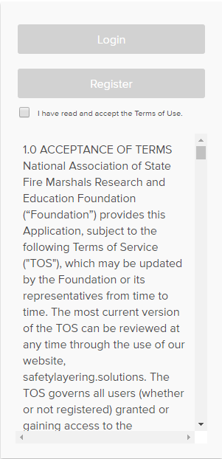
Register and Login
www.safetylayering.solutions
After reading and agreeing to the Terms of Service you can register for a new account, or login to an existing account, providing you unlimited access to use the Risk Evaluation MATRIXTM
www.safetylayering.solutions
Notes:
To access the Risk Evaluation MATRIXTM please go to www.safetylayering.solutions to register or login to your account. As one of the selected communities participating in the data collection phase, you have already been assigned an account, please enter the login information that was provided to you. Remember that more than one user can use the same login to access the application during this phase of project. For future use you will need to create an account for continued use of the tool.
********************************Once you have accessed the tool at safetylayering.solutions you will see the screen shown on the right. After reading and agreeing to the Terms of Service, you will be able to register for a new account or login to an existing account.

Slide 6
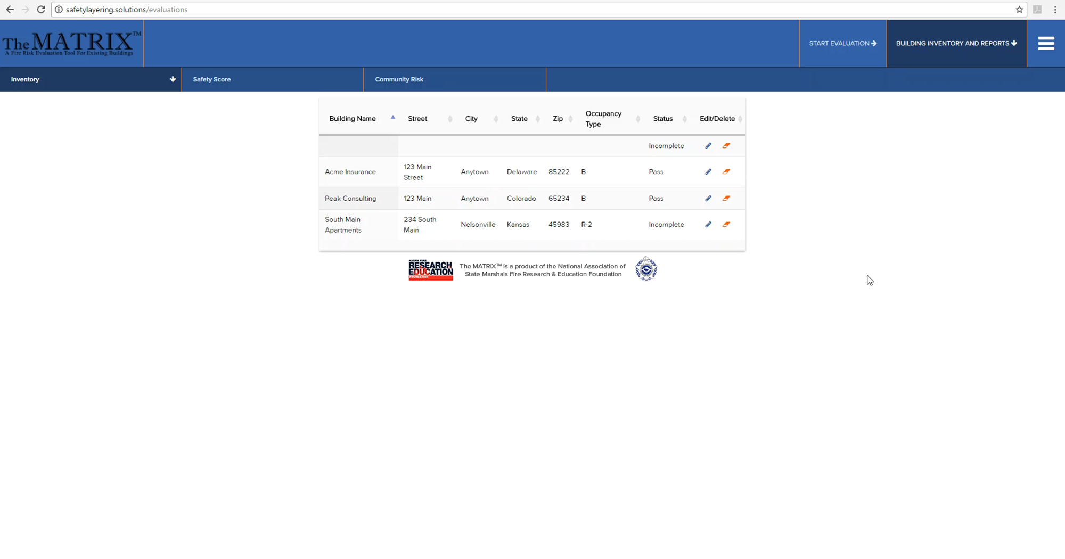
Notes:
After logging in you will see a screen that looks similar to what you see on your screen now. We have included a short demonstration for you on the basics of navigation within the Risk Evaluation MATRIXTM.
As you watch the demonstration, remember that your answers are saved every time you hit the save and continue button AND every time you navigate away from any page. We have made every attempt to organize the questions in a logical manner that will allow you to systematically work your way through a building, but it is not imperative that you follow the navigation exactly as it is presented. Your final results will be the same regardless of what order you answer the questions in.
Keep an eye on the running score total in the upper right of your screen to judge your progress. At times a Critical Failure button will appear below the scores. If this appears, don’t be alarmed, it simply may mean that additional information is required before completing the evaluation. Just click on the button and it will tell you any areas of concern you may need to address. In other circumstances it may alert you to a dangerous situation that results in an automatic failure of the building. An example of this would be an I-2 occupancy that does not have a sprinkler system installed throughout the building. In this instance there is no need to continue the evaluation as it has already be scored as a failure. The circumstances should be rare, but it is important to watch for them as you use the tool.
Now, let’s watch the video.

Slide 7
Notes:
After logging in you will see a screen that looks similar to what you see on your screen now. We have included a short demonstration for you on the basics of navigation within the Risk Evaluation MATRIXTM.
As you watch the demonstration, remember that your answers are saved every time you hit the save and continue button AND every time you navigate away from any page. We have made every attempt to organize the questions in a logical manner that will allow you to systematically work your way through a building, but it is not imperative that you follow the navigation exactly as it is presented. Your final results will be the same regardless of what order you answer the questions in.
Keep an eye on the running score total in the upper right of your screen to judge your progress. At times a Critical Failure button will appear below the scores. If this appears, don’t be alarmed, it simply may mean that additional information is required before completing the evaluation. Just click on the button and it will tell you any areas of concern you may need to address. In other circumstances it may alert you to a dangerous situation that results in an automatic failure of the building. An example of this would be an I-2 occupancy that does not have a sprinkler system installed throughout the building. In this instance there is no need to continue the evaluation as it has already be scored as a failure. The circumstances should be rare, but it is important to watch for them as you use the tool.
Now, let’s watch the video.

Slide 8
Practice Makes PeRfect!
Select Familiar Buildings
Work as a Team
Refer to the Code Books
Rely on the Help Buttons
Notes:
Now that you have seen the basics of the tool, it’s time to start using it yourself.
*******************As with any new tool, it takes some time to become familiar with how to use it efficiently and effectively. There’s no better way to do this than by practicing on buildings you already know very well. Consider practicing evaluations on your administration building or one of your fire stations to get used to the navigation and features. A restaurant you frequent regularly could be another good choice. After a short time you will become more familiar with the tool and should move to more difficult or unfamiliar buildings to sharpen your skills.
********************Whatever buildings you choose to practice with, if time allows, work with a colleague until you each become familiar with how the questions are asked and how to answer them appropriately. Relying on your shared knowledge will pay dividends down the road.
**********************You may need to refer to various code books, especially as you become familiar with using the Risk Evaluation MATRIXTM. While it is not important whether your jurisdiction has adopted the International Existing Building Code or not, having it handy will help to understand how the information gathered is calculated. You may also need to refer to the Building Code, Fire Code and Mechanical Code. NFPA 13 is the final companion document that you may need to refer to from time to time. As you become more familiar with the tool, your reliance on the codes and standards will become less and less.
************************We have made every attempt to anticipate questions you may have by providing clarifications and code references in the help buttons located next to each question. Refer to the often if you are unsure what is being asked or how to answer a question. Remember, it is important that you answer all questions thoroughly to ensure the risk evaluations you perform are accurate and reliable.

Slide 9
Using the NASFM Risk Evaluation MATRIXTM
www.safetylayering.solutions
Presented by
National Association of State Fire Marshals
Notes:
In this training we have looked at important areas and information to help you as you utilize the tool. We have also looked at how to register and login to the tool as well as shown the basic navigational elements. Remember that at all times you can edit any previous answer if more information becomes available. As with any new software tool, practice makes perfect, so we encourage you to explore and utilize it to gather and analyze information to help you protect your citizens and fellow firefighters.
Thank you for your time and learning more about Using the NASFM Risk Evaluation MATRIXTM

