Slide 1
Project FAIL-SAFE
Jon Narva
Director of External Relations
NASFM Fire Research & Education Foundation

Slide 2
Project FAIL-SAFE Goal
Provide quantifiable data on the value of multiple layers of safety in structures
We simply don’t know how individual components integrate with each other when viewed holistically.
Life Safety
Incident Stabilization
Property Conservation and Resiliency
Notes:
The is little or no scientific research on this subject

Slide 3
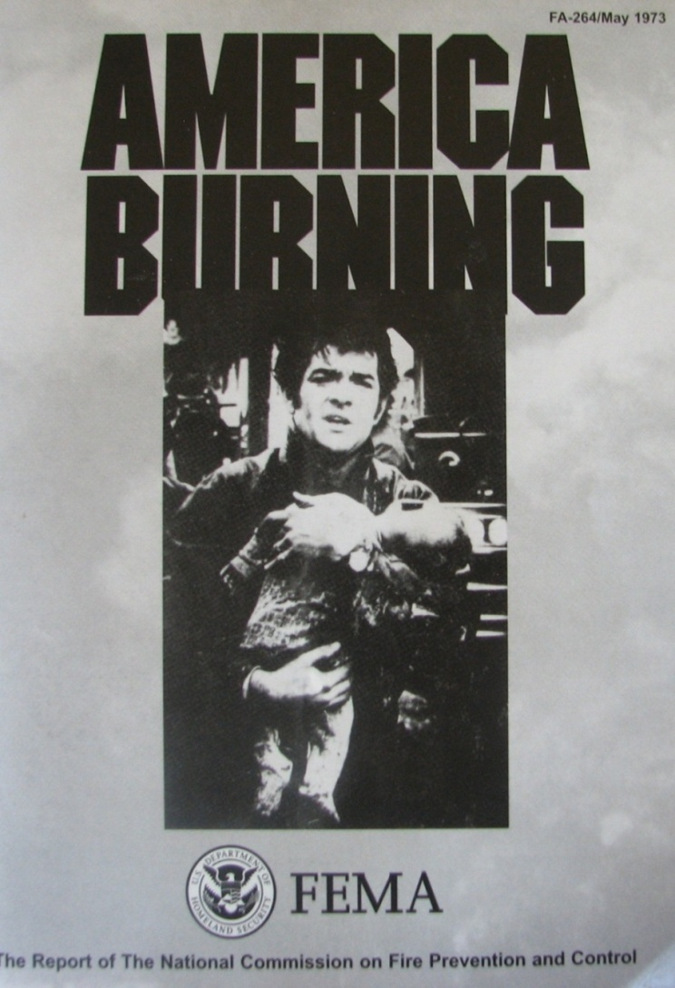
Landmark FEMA
Report Released in 1974, revisited in 1987, introduced trade-off concept
Recommended the increased and widespread use of automatic sprinkler systems.
3
Notes:
Provided the important impetus to include fire sprinkler systems in more occupancy types and buildings.

Slide 4
“…automatic sprinklers can pay for themselves in damages prevented, and the model codes should permit other savings by relaxing requirements for other fire safety features when automatic sprinklers are installed.” Source: page 83, America Burning (1974)
America Burning
“…trade-offs of current fire code requirements in return for installation of automatic detection and suppression systems may become a common approach to providing fire protection in the built environment.” Source: page 75, America Burning Revisited(1987)
4

Slide 5
America Burning
“Much of what is known about fire safety is simply being ignored. Indeed, enough is known about fire safety to permit a reliable application of a sophisticated systems approach to fire safety design”
Source: page 73, America Burning (1974)
Notes:
The need for a holistic approach to building fire safety was called out.

Slide 6
What is the Justification for New Trade-offs?
The AMERICA BURNING reports did not provide any recommendation or guidance on how much or how little built-in fire protection should be permitted to be traded-off for sprinklers.
“The Commission recommends that the National Bureau of Standards, in cooperation with the National Fire Protection Association and other appropriate organizations, support research to develop guidelines for a systems approach to fire safety in all types of buildings.”
Source: page 75, America Burning (1974)
6
Notes:
This need is the focus of the Project FAIL-SAFE research…develop a systems approach.

Slide 7
National Fire Protection Association (NFPA)
"Unsatisfactory fire protection performance can occur if the building’s design does not address all five elements of an integrated system – slowing the growth of fire, automatic detection, automatic suppression, confining the fire, and occupant evacuation..”
Source: NFPA Fire Protection Handbook, Section 1, Chapter 1 of the 20th edition (2008)
7
Notes:
Major organizations all recognize the need to provide for multiple layers of fire safety including the NFPA.

Slide 8
2012 NFPA 5000 Construction Code
Section 4.4.1 Fundamental Fire and Life Safety Requirements (Prescriptive path)
Section 4.4.1 Multiple Safeguards
The design of every building or structure intended for human occupancy shall be such that reliance for property protection and safety to life does not depend solely on any single safeguard. An additional safeguard(s) shall be provided for property protection and life safety in case any single safeguard is ineffective due to inappropriate human actions, building failure, or system failure.
8

Slide 9
National Institute of Standards and Technology (NIST)
Building fire protection is based on a four-level hierarchical strategy comprising detection, suppression (sprinklers and firefighting), compartmentation and passive protection of the structure.
Source: 1996 NIST NCSTAR 1-1WTC Investigation, Executive Summary, Finding 22, Draft for Public Comment
9
Notes:
NIST was established as an outcome of the America Burning report.

Slide 10
2015 International Codes
Section 101.3 Intent
Establish minimum requirements to safeguard public health, safety and general welfare.
Safety to life and property from fire and other hazards.
To provide safety to fire fighters and emergency responders during emergency operations.
DOEs the minimum MEET PUBLIC EXPECTATIONS?
10
Notes:
How do we meet the expected safety and does acceptable risk exceed the minimums? Project FAIL-SAFE is working to better understand this and provide scientifically valid research.

Slide 11
NASFM Partnership for Safer Buildings 2002-2006
1. Balance and redundancy are the keys to good fire protection.
2. Reverse the trends toward less expensive construction in favor of safe construction in new codes.
3. Except were lives can be saved, Fire Chiefs may now allow buildings to burn rather than risk fire fighters’ lives.
Source: www:firemarshals.org
11
Notes:
NASFM has been engaged on the issue of safety layers since 2002.

Slide 12
“We think we've gone too far with the trade-offs in the codes, and we're seeking to reverse that trend”
New York State Fire Administrator James Burns, president (past) of the National Association of State Fire Marshals.
USA Today
February 12, 2006
Notes:
Continuing the work begun with the Partnership For Safer Buildings, Project FAIL-SAFE aims to provide answers to what level of trade-offs, and what combination of them is both economically feasible and an improvement in life safety and building resiliency.

Slide 13
The Million Dollar Question?
Do the model code’s provide for holistic building safety and resiliency based on valid scientific research?

Slide 14
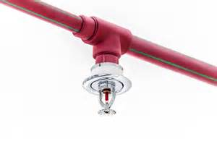
The New “Baseline” for Life Safety
Fire Sprinkler Systems can improve fire safety in every building, but…
…have sprinkler trade-offs gone too far?
…is there more room for additional trade-offs?
…how do we determine which trade-offs, or combination of trade-offs, are safe?
Notes:
We have now largely come to understand the value of ensuring as many of our buildings are equipped with properly design and fully functional automatic fire protection sprinkler systems. The question that remains is what redundant layers of fire safety features will provide enhanced safety and resiliency.

Slide 15
Project FAIL-SAFE Highlights
Code
Analysis
Literature Review
Computer Modeling
MATRIX Development
4 primary research bands
9 phases of research
The MATRIX to provide “real-world” look at academic work
Clear evidence to inform code decisions at the national, state and local levels
Notes:
Looks at both existing building stock and new buildings as part of the research.

Slide 16
Code Analysis
Code
Analysis
FIRE Tool (Fire Incident Risk Evaluation)
Characteristics and requirements in the 2015 International Building Code.
Combination of Occupancy Group and Construction Type
Notes:
Using the 2015 IBC a tool was built to analyze required safety features based on a combination of construction type and occupancy type. WPI used the tool to identify those combinations that exhibit the highest number of trade-offs, or reduction in the presence of multiple layers of fire safety.

Slide 17
Literature Review
Literature
Review
Previous research in this area?
What do we already know?
What can we learn from it?
What knowledge gaps exist?
Notes:
Utilizing findings from the code analysis, WPI reviewed valid research to identify knowledge gaps in the scientific understanding of holistic fire protection features.

Slide 18
Computer Modeling
Computer
Modeling
Comparative analysis
Movement of fire and fire by-products
Detection, evacuation, compartmentation and suppression
Structural stability of individual components and holistically
Notes:
Computer modeling performed by WPI to investigate the knowledge gaps identified from the literature review.

Slide 19
NASFM Foundation MATRIX
MATRIX
Development
and Analysis
Master Analytical Tool for Risk IndeXing
Evaluate existing buildings IEBC 1401
A-1, A-2, A-3, A-4, B, E, F-1, F-2, I-2, M, R-1, R-2, R-4, S-1, S-2
23 critical, quantifiable parameters
Over 200 data points per building
Web-based app with data analytics
Notes:
Web-based app developed to systematically perform risk analysis of existing building. The tool will be provided free of charge to the fire service to aid in evaluating buildings within their jurisdictions. A statistical analysis of the collected data provides valid observations on strengths, weaknesses and trends within existing building risk factors.

Slide 20
So, how does the MATRIX work anyway?

Slide 21
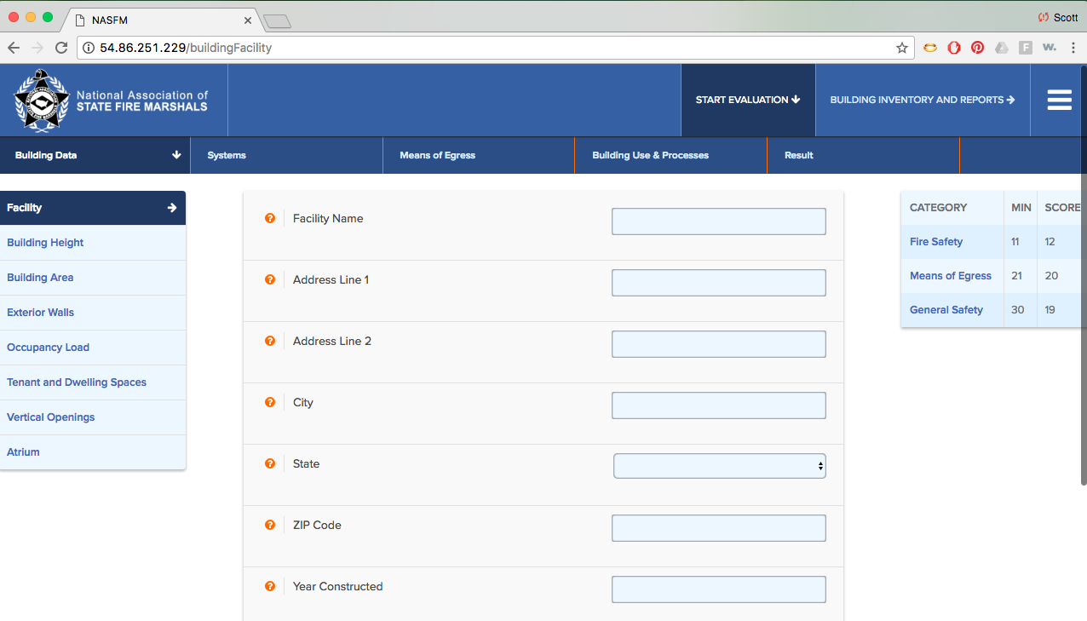
A “snapshot” of the MATRIX
Notes:
The evaluation is organized into four areas of Input: Building Data, Systems, Means of Egress, and Building Use & Processes. These major sections are organized across the top of the screen.
Within each of the major sections, there are sub-sections that contain the input questions relative to that section.

Slide 22
IEBC Chapter 14 Risk Assessment Categories
IEBC Code Section | Safety Parameter | Fire Safety (FS) | Means of Egress (ES) | General Safety (GS)
1401.6.1 | Building Height
1401.6.2 | Building Area
1401.6.3 | Compartmentation
1401.6.4 | Tenant and Dwelling Unit Separations
1401.6.5 | Corridor Walls
1401.6.6 | Vertical Openings
1401.6.7 | HVAC Systems
1401.6.8 | Automatic Fire Detection
1401.6.9 | Fire Alarm Systems
1401.6.10 | Smoke Control | NA
1401.6.11 | Means of Egress Capacity | NA
1401.6.12 | Dead Ends | NA
1401.6.13 | Maximum Exit Access Travel Distance | NA
1401.6.14 | Elevator Control
1401.6.15 | Means of Egress Emergency Lighting | NA
1401.6.16 | Mixed Occupancies |  | NA
1401.6.17 | Automatic Sprinklers
1401.6.18 | Standpipes
1401.6.19 | Incidental Uses
1401.6.20 | Smoke Compartmentation
1401.6.21.1 | Patient Ability for Self-preservation | NA
1401.6.21.2 | Patient Concentration | NA
1401.6.21.3 | Attendant-to-patient Ratio | NA
Total Building Score
Notes:
All 23 categories are mandatory for completion. Each category is scored according to formulas and values established in 2015 IEBC Chapter 14. The category scores are added together with the requirement to meet the minimum total score prescribed by the IEBC.

Slide 23
Total Score Sheet Example
IBC | Safety Parameters | Fire Safety (FS) | Means of Egress (ME) | General Safety (GS)
1401.6.1 | Building Height | 1 | 1 | 1
1401.6.2 | Building Area | 15 | 15 | 15
1401.6.3 | Compartmentation | 20 | 20 | 20
1401.6.4 | Tenant and Dwelling Unit Separations | 0 | 0 | 0
1401.6.5 | Corridor Walls | 0 | 0 | 0
1401.6.6 | Vertical Openings | 0 | 0 | 0
1401.6.7 | HVAC Systems | -15 | -15 | -15
1401.6.8 | Automatic Fire Detection
1401.6.9 | Fire Alarm Systems | 2 | 2 | 2
1401.6.10 | Smoke Control | N/A | 0 | 0
1401.6.11 | Means of Egress Capacity | N/A | 0 | 0
1401.6.12 | Dead Ends | N/A
1401.6.13 | Maximum Exit Access Travel Distance | N/A | 16 | 16
1401.6.14 | Elevator Control | -2 | -2 | -2
1401.6.15 | Means of Egress Emergency Lighting | N/A | 1 | 1
1401.6.16 | Mixed Occupancies | 0 | N/A | 0
1401.6.17 | Automatic Sprinklers |  | 0
1401.6.18 | Standpipes
1401.6.19 | Incidental Uses | 0 | 0 | 0
1401.6.20 | Smoke Compartmentation | N/A | N/A | N/A
1401.6.21.1 | Patient Ability for Self-preservation | N/A | N/A | N/A
1401.6.21.2 | Patient Concentration | N/A | N/A | N/A
1401.6.21.3 | Attendant-to-patient Ratio | N/A | N/A | N/A
 | Building Score - Total Value | 21 | 38 | 38
 | Minimum Passing Score | 30 | 40 | 40
 | Pass/Fail | No | No | No
Notes:
Chapter 14 of the IEBC assesses 23 different quantifiable values using formulas and values established by the chapter.

Slide 24
Data Analysis Possibilities
Value to the future by looking backward
Strengths, weakness and trends
Comparative analysis of 23 individual parameters
Combinations of the 23 parameters
Comparative analysis of 3 categories (fire safety, egress, general safety)
Within each of the 3 categories
Filter results further based on:
Year built, building code used, occupancy group, construction type.

Slide 25
Questions?
Jon Narva
202-393-7015
jon@narvaassociates.com

